Slide 1

Ejikeme Ekene Samuel
August, 2025
CO-METALS BIKE SALES REPORT
(2011-2016)

Slide 2
INTRODUCTION
This report provides the analysis of Co-Metals Bike sales data from 2011-2016 to uncover key trends and insights that can support informed business decisions. The analysis focuses on metrics such as total revenue, top-performing products, customer demographics, and regional sales distribution. By exploring these factors, the report aims to highlight areas of strong performance and identify opportunities for growth and optimization in sales strategy.

Slide 3
DATA ANALYSIS WORKFLOW
Data collection
Data cleaning
Data visualization
Recommendation
Conclusion
Analysis and Insight

Slide 4
DATA CLEANING PROCESS
Checked missing values
Correct typos and errors
Filtered out irrelevant data
Trimmed spaces
Create consistent categories
Data type conversion

Slide 5
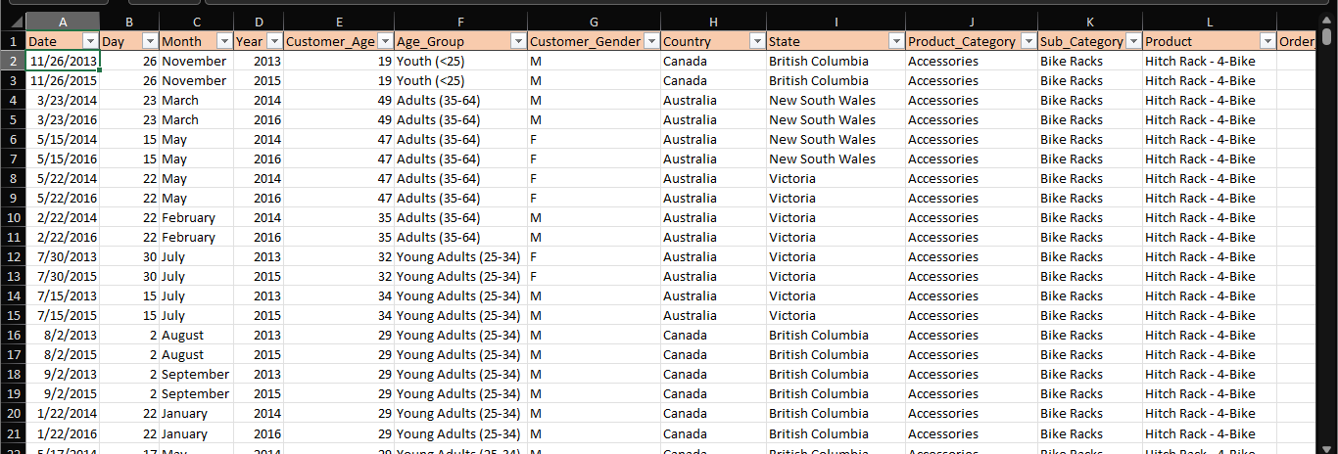
FINAL DATASET OVERVIEW

Slide 6
INSIGHT AND ANALYSIS
Total revenue: $85.3m
Total sales: $95.2m
Total cost: $53m
Gross Profit: $32.3m
GPM: 38%
Total no of customers: 113k
Total unit sold: 1.35m

Slide 7
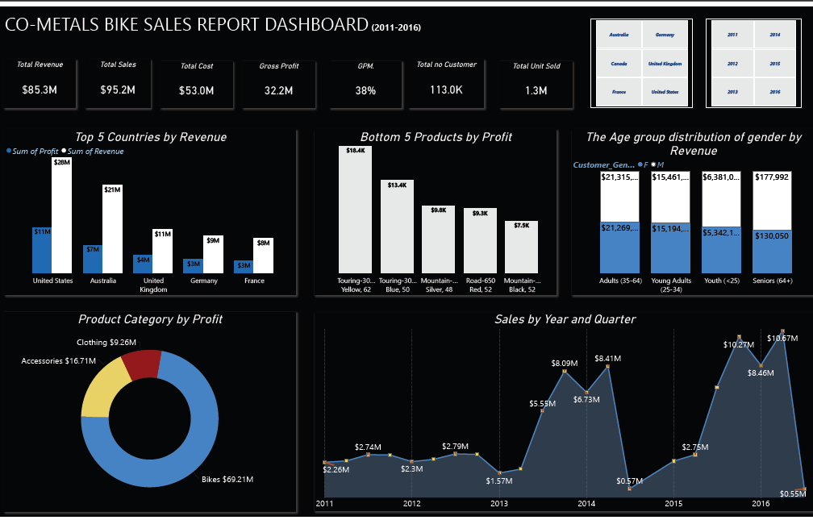
DATA VISUALIZATION. 1

Slide 8
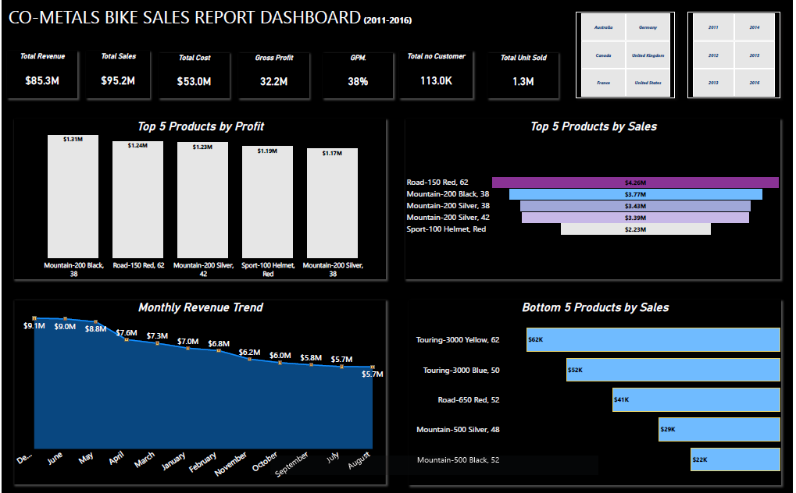
DATA VISUALIZATION. 2

Slide 9
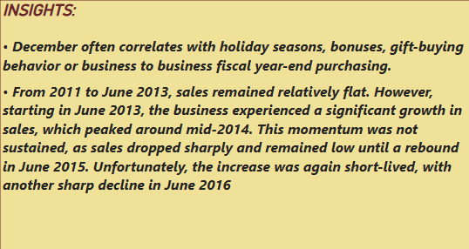
OBSERVATIONS

Slide 10
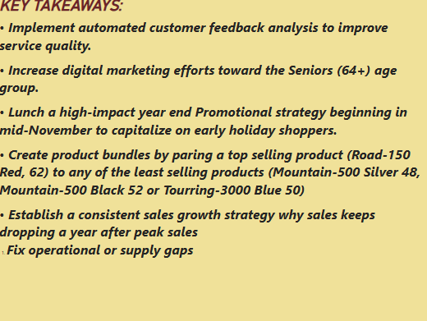
RECOMMENDATIONS

Slide 11
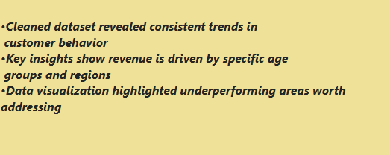
CONCLUSION

Slide 12
THANK YOU
THANK YOU

